Slide 1
Patient Care Coordination Dynamic Care Team Management Profile (DCTM)
Presented by Emma Jones, Jeff Danford

Slide 2
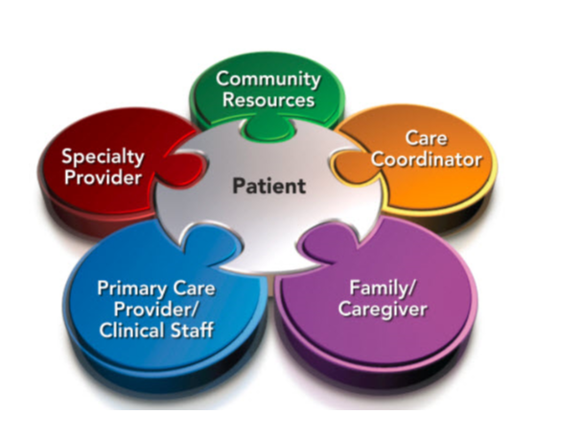
Dynamic Care Team Management - DCTM (FHIR)

Slide 3
The Problem
Sharing of patient data to support care coordination is static, not dynamic, and may lead to possible underuse, overuse and mis-use of healthcare services
Care teams have many different meanings to many different people
We need a useful way to consolidate these multiple teams and coordinate care

Slide 4
The Solution
Coordination Framework:
HL7 Care Team DAM as the model framework
HL7 Care Coordination Service Functions
HL7 FHIR Resource and IHE Profiles to support CCS Capabilities
Care Plan Management
Care Team Membership
Care Team Communication

Slide 5
DCTM Overview
The Dynamic Care Team Management (DCTM) Profile provides a mechanism to facilitate system interactions to support care team membership such as:
Discovering Care Teams
Updating Care Teams
Listing Care Teams

Slide 6
DCTM Details
Provides the structures and transactions for care team management and sharing information about Care Teams that meet the needs of many, such as providers, patients and payers.
Depicts how information about multiple care teams can be shared and used to coordinate care.
Care Teams can be dynamically updated as the patient interacts with the healthcare system.
A patient and providers may be associated with multiple types of care teams at any given time.
Standards
HL7 FHIR CareTeam and Subscription resources
HL7 Coordination of Care Services (CCS) Functional Model

Slide 7
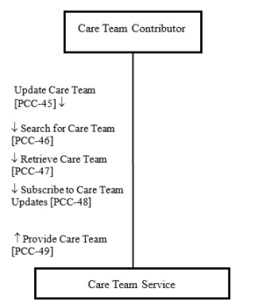
DCTM Actors and Transactions

Slide 8
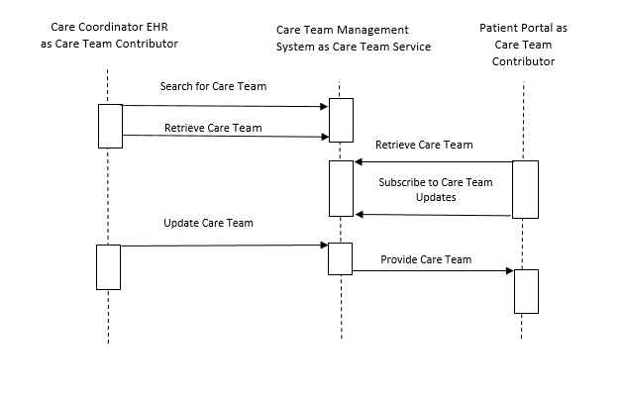
DCTM Basic Process Flow

Slide 9
DCTM Use Case
Reuses the HL7 Care Plan Domain Analysis Model specification storyboard 2: Chronic Conditions
Depicts care team management needed for chronic disease management as well as transition of care episodes
Use case is sub-divided to reflect HL7 LHS Care Team Definition Project’s classification of types of care teams

Slide 10
Next Steps ….
IHE PCC 2019 Proposal
Update DCTM by providing the ability to create/update care teams dynamically as part of care planning/care coordinating workflows
Reflect HL7 Care Team DAM work (LHS WG)

Slide 11
PCC 2019 Profile Proposal: Creating/Updating CareTeams
Care Planning Guidance Service
Provider Directory
eRx
EHR
EHR
Lab
etc
Select Patient
Add Diagnosis
Pass Diagnosis
PlanDefinitions
Associate
Diagnosis
Select PlanDefinition
PlanDefinitions ID
Applicable
ActivityDefinitions
Interventions:
Referrals
CareTeam
Participants
Organization
CareTeam
All ActivityDefinitions
Select ReferralRequest,
CareTeam components
Save CarePlan (Draft)
Nutritionists, Hospitals (by Zip code, etc)
Providers, organizations available
Response
Update CarePlan
And save CarePlan (Draft)
Send Request Resources
Return Response
Update
Update CarePlan with
Various resource statuses
Update CarePlan with dateTime Stamp

Slide 12
Questions?

